Slide 1



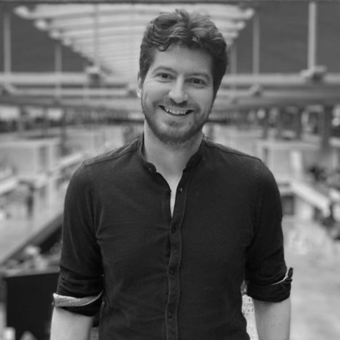

Arthur Segard – Mission Lead
Professional experience
Education and skills
4 years at McKinsey & Company, Casablanca & Paris with a strong focus on Africa serving in Côte d‘Ivoire, France, Gabon, Mauritius, Morocco and Togo, with responsibility up to project manager level, e.g.
Supported large organizational change for a multinational financial institution, including the establishment of new shared services hubs
Led sub-sector analysis and the development of a strategic vision for an industrial and financial conglomerate, involving the redeployment of their portfolio as well as digitalization projects
Assessed the impact of a large infrastructure project, with a focus on risk mitigation
Supported multilateral coordination in the deployment of a large industrial investment involving a large SOE and its suppliers
Before working in consulting, Arthur worked as an Economist in charge of sector-specific macroeconomic forecasting, as a Policy Analyst for an international think tank, and managed operations for an emergency relief NGO (funded by UNICEF, EuropeAid, USAID, DFID, AFD…) in the warzones of Darfur, Sudan and Kivu, DRC
Arthur holds a Master’s Degree of Sciences from Po Paris, with a major in Macroeconomics; he spent a year as an exchange student at the Universität zu Köln
He also holds a Master’s Degree in Financial Law, jointly awarded by Faculté Jean Monnet and ESCP Europe; he completed 2 internships (Legal Department and Market Floor) at Société Générale Investment Banking
Arthur speaks French and English fluently and is able to have professional conversations in German. He has basic knowledge in Swahili
Introduction
A former McKinsey Engagement Manager with prior field operations management experience in Africa, Arthur can bring together a holistic strategic vision and pragmatic hands-on problem solving.
To make the world a better place, getting the local economic equation right is key; I am passionate about solving complex issues to unlock economic development trajectories.

